Slide 1
C++ Basic OOP Review
COP 3003 Programming II
FGCU

Slide 2
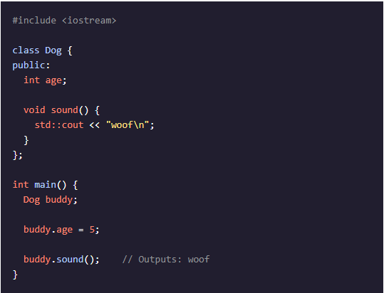
Classes and Objects
A C++ class is a user-defined data type that encapsulates information and behavior about an object.
A class can have two types of class members:
Attributes, also known as member data, consist of information about an instance of the class.
Methods, also known as member functions, are functions that can be used with an instance of the class.
An object is an instance of a class and can be created by specifying the class name.
[code]cademy: Cheatsheets / C++ for Programmers: Object-Oriented Programming in C++
URL: https://www.codecademy.com/learn/c-plus-plus-for-programmers/modules/object-oriented-programming-in-cpp/cheatsheet

Slide 3
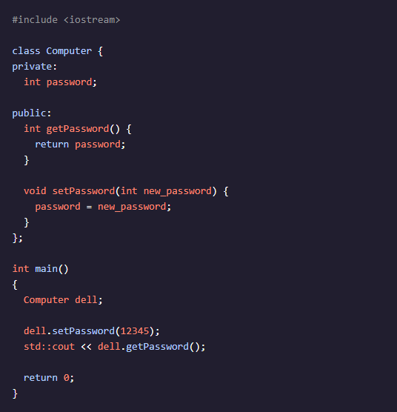
Access Specifiers
Access specifiers are C++ keywords that determine the scope of class components:
public: Class members are accessible from anywhere in the program.
private: Class members are only accessible from inside the class.
Encapsulation is achieved by declaring class attributes as private:
Accessor functions (getters): return the value of private member variables.
Mutator functions (setters): change the value of private member variables.
[code]cademy: Cheatsheets / C++ for Programmers: Object-Oriented Programming in C++
URL: https://www.codecademy.com/learn/c-plus-plus-for-programmers/modules/object-oriented-programming-in-cpp/cheatsheet

Slide 4
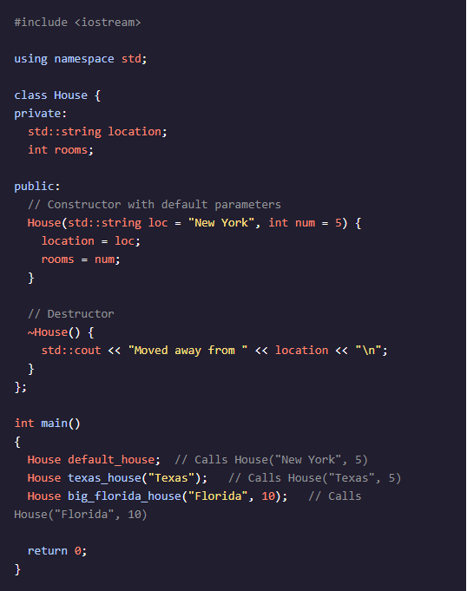
Constructors
For a C++ class, a constructor is a special kind of method that enables control regarding how the objects of a class should be created. Different class constructors can be specified for the same class, but each constructor signature must be unique.
Constructors must have the same name as the class (with the same capitalization)
Constructors have no return type (not even void)
A constructor can have multiple parameters as well as default parameter values.
A default constructor has no parameters.
The compiler will generate a default constructor if none is provided, but still leaves members uninitialized.
[code]cademy: Cheatsheets / C++ for Programmers: Object-Oriented Programming in C++
URL: https://www.codecademy.com/learn/c-plus-plus-for-programmers/modules/object-oriented-programming-in-cpp/cheatsheet

Slide 5
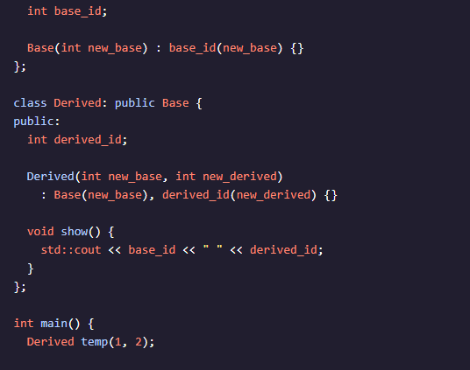
Inheritance
In C++, a class can inherit attributes and methods from another class. In an inheritance relationship, there are two categories of classes:
Base class: The class being inherited from.
Derived class: The class that inherits from the base class.
It’s possible to have multi-level inheritance where classes are constructed in order from the “most base” class to the “most derived” class.
[code]cademy: Cheatsheets / C++ for Programmers: Object-Oriented Programming in C++
URL: https://www.codecademy.com/learn/c-plus-plus-for-programmers/modules/object-oriented-programming-in-cpp/cheatsheet

Slide 6
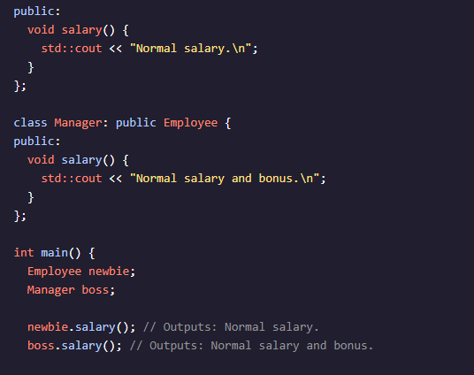
Polymorphism
In C++, polymorphism occurs when a derived class overrides a method inherited from its base class with the same function signature.
Polymorphism gives a method many “forms”. Which form is executed depends on the type of the caller object.
[code]cademy: Cheatsheets / C++ for Programmers: Object-Oriented Programming in C++
URL: https://www.codecademy.com/learn/c-plus-plus-for-programmers/modules/object-oriented-programming-in-cpp/cheatsheet

Slide 7
Object Composition
Complex objects are often built from smaller, simpler objects
Examples in C++ are:
structs
classes
The process of building complex objects from simpler ones is called object composition
Subtypes
Composition
Aggregation
LearnCPP.com (https://www.learncpp.com/)

Slide 8
Composition
To qualify as a composition, an object and a part must have the following relationship:
The part (member) is part of the object (class)
The part (member) can only belong to one object (class) at a time
The part (member) has its existence managed by the object (class)
The part (member) does not know about the existence of the object (class)
Relationship type – “has-a”
Example – Person’s heart
LearnCPP.com (https://www.learncpp.com/)

Slide 9
Aggregation
To qualify as an aggregation, a whole object and its parts must have the following relationship:
The part (member) is part of the object (class)
The part (member) can belong to more than one object (class) at a time
The part (member) does not have its existence managed by the object (class)
The part (member) does not know about the existence of the object (class)
Relationship type – “has-a”
Example – Car’s Engine
LearnCPP.com (https://www.learncpp.com/)

Slide 10
Association
To qualify as an association, an object and another object must have the following relationship:
The associated object (member) is otherwise unrelated to the object (class)
The associated object (member) can belong to more than one object (class) at a time
The associated object (member) does not have its existence managed by the object (class)
The associated object (member) may or may not know about the existence of the object (class)
Relationship type – “has-a” through a “uses-a” relationship
Example: Doctor and Patient
LearnCPP.com (https://www.learncpp.com/)

Slide 11
Inheritance
Creating new objects by directly acquiring the attributes and behaviors of other objects and then extending or specializing them
Relationship type – “is a”
Example: Dog is an Animal
LearnCPP.com (https://www.learncpp.com/)

